Slide 1
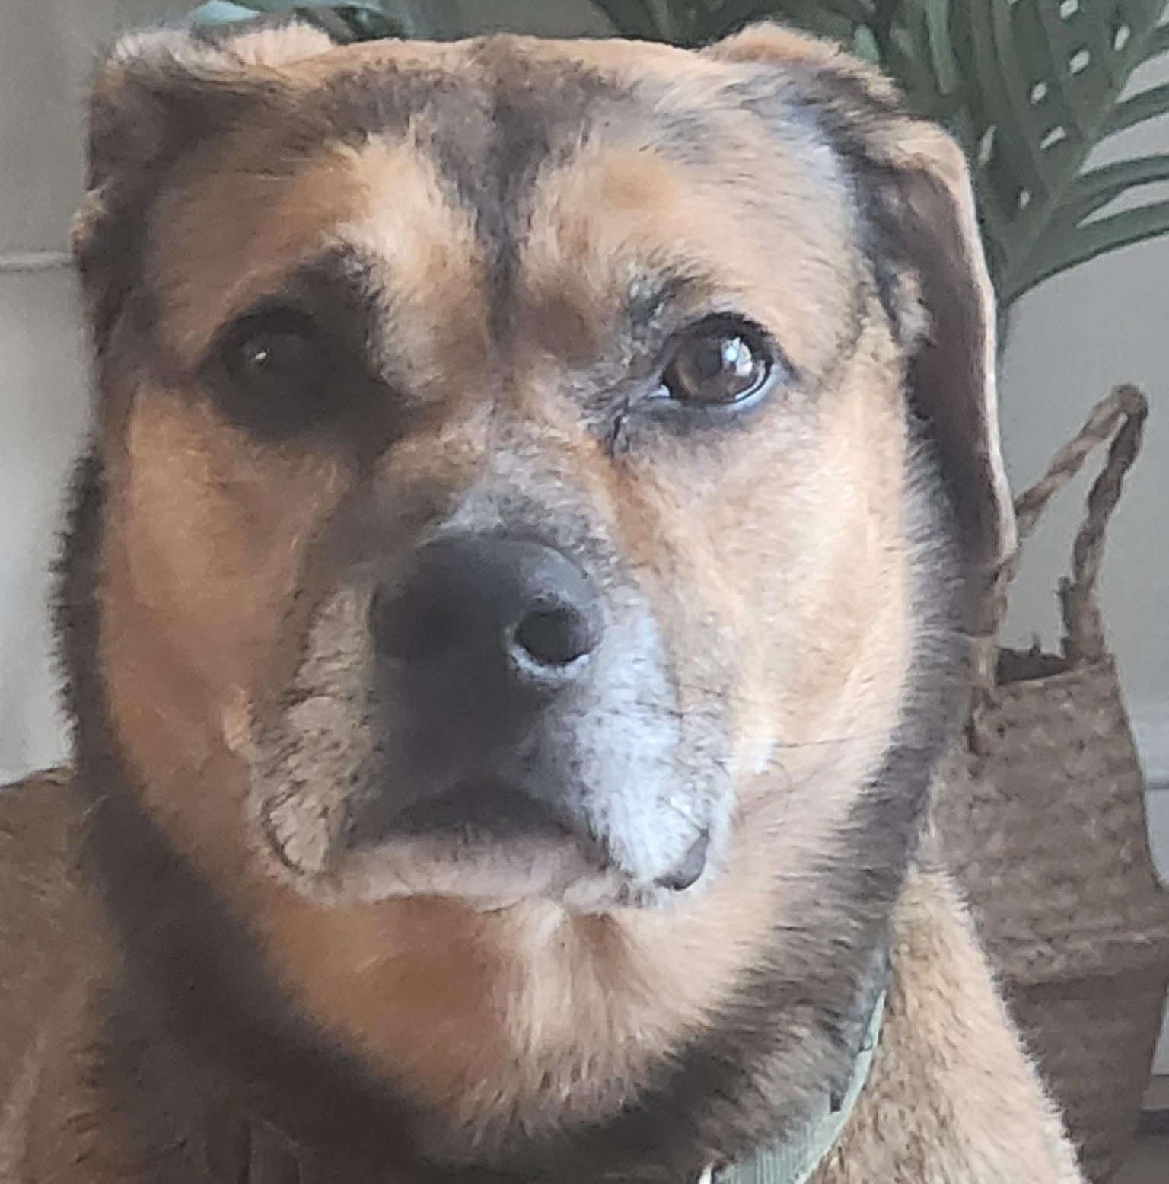
DATE
EVAN SMITH
Citizenship 9
Insert some kind of cool picture here

Slide 2
TABLE OF CONTENTS
TABLE OF CONTENTS
WHERE
1
2
3
4
Personal
Community
Global
Aspirational

Slide 3
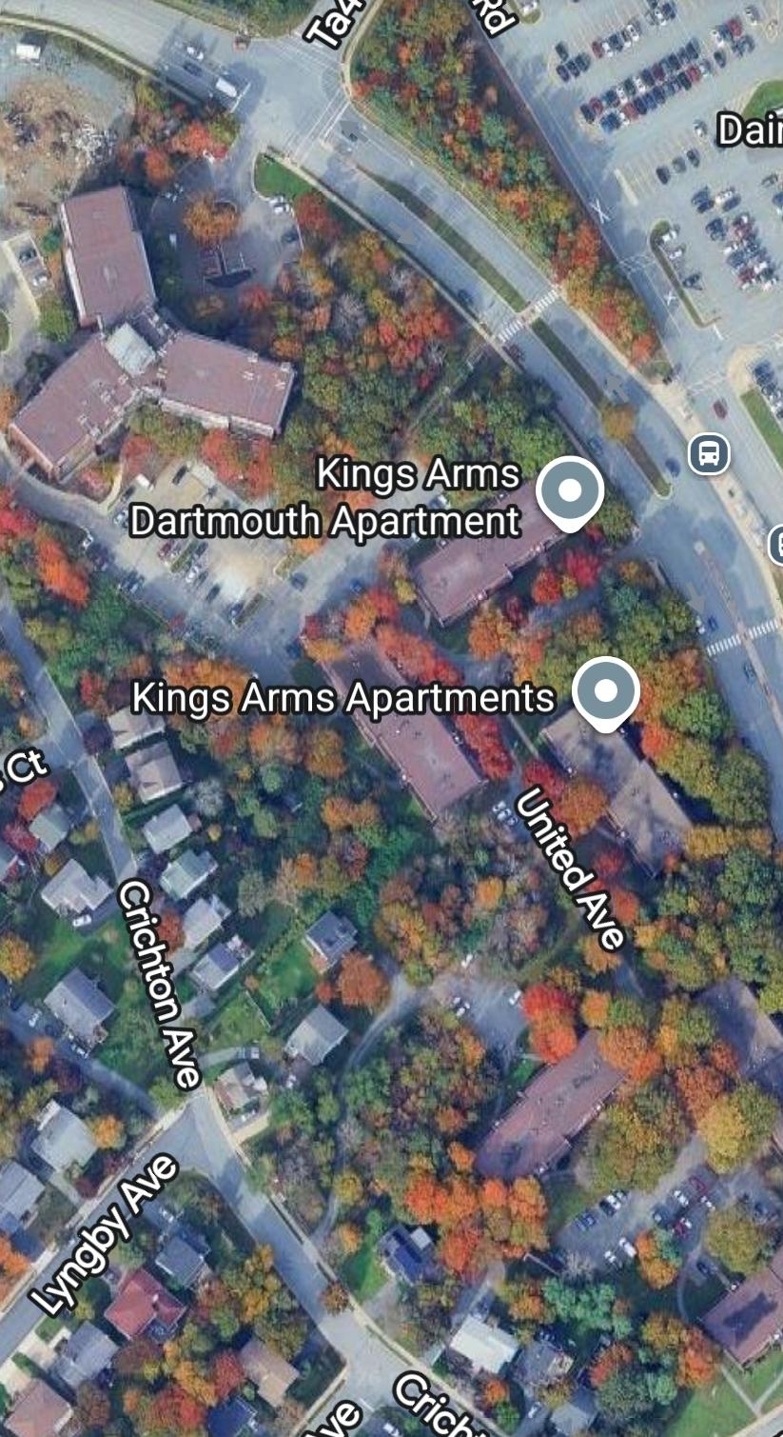
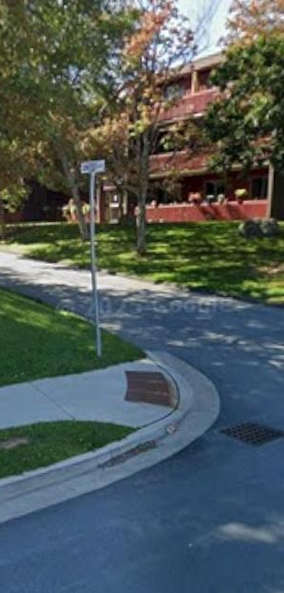
The Personal Place
Cit 9 WHERE
MAP SCREENSHOT (from Bing Maps) | My apartment building. I've been here for a great 6 years, and I've made plenty of memories while living here. I've been able to see many places while living here, from around the city, around the country and around the world. From making plenty of friends, shopping at Mic Mac Mall, and everything in between, I love living here. | IMAGE
Notes:
The Personal Place
Reflection: Write a paragraph about a personal place that holds significance for you.
Guiding Questions:: In a second section, describe how your personal perspective shapes the way you see and feel about this place. What stories or memories are tied to this specific location?

Slide 4
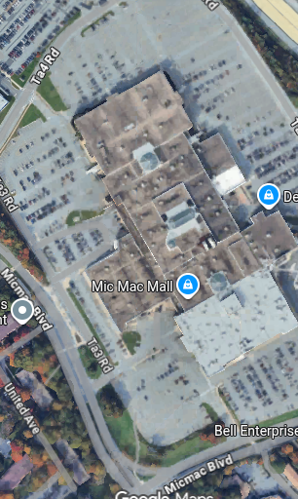
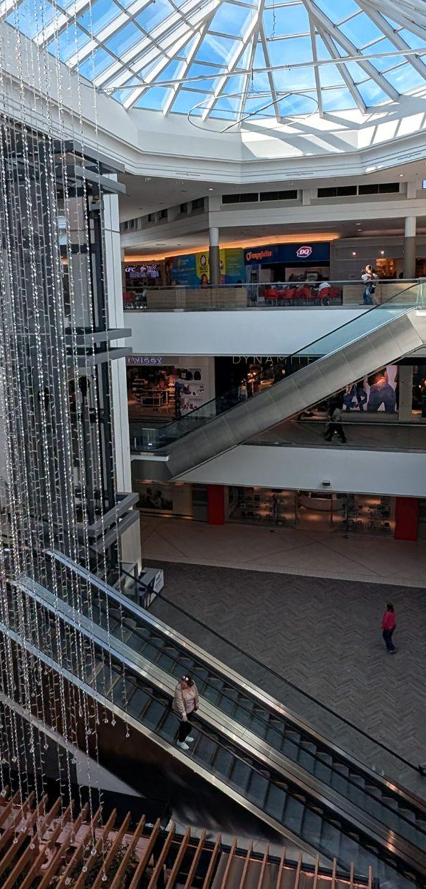
The Community Place
Cit 9 WHERE
MAP SCREENSHOT | Mic Mac Mall. I go there and it is quite enjoyable to eat, shop and burn some spare time. It’s a nice hangout spot to meet up with my friends. I haven’t had a true food court supper yet, but I plan to do it eventually. With everything from the food court to Shoppers, and H&M to Decathalon, I always have a good time at Mic Mac Mall, especially with a friend. | IMAGE
Notes:
Reflection: Write about a significant place in our local community. Tell the story of the place! Who owns it? Why do you like it? Describe something that happened there that you remember.

Slide 5
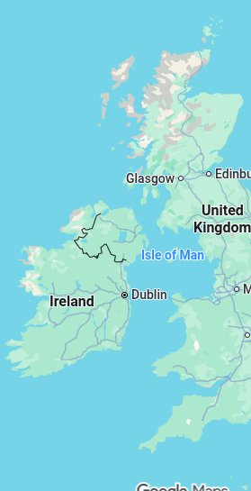
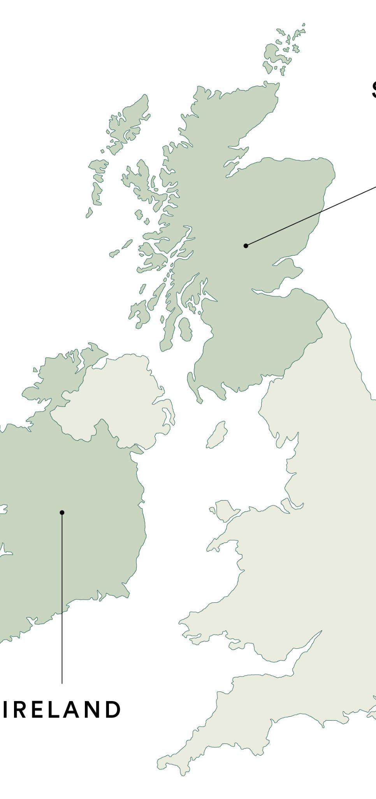
The Global Place
Cit 9 WHERE
MAP SCREENSHOT | I know that my family comes from the Scotland/Ireland area. Unfortunately that's all that I know. I believe that there might be some French in there, but I know that a while ago, my family lived in Ireland or Scotland, and packed ship over to Canada. I wish that I could tell more, but I don't know my family tree all too well, so I hope that this makes well enough to supplement it. | IMAGE
Notes:
Reflection: Write a story about a place in the world that is part of your family's story.
Guiding Questions: Tell the story of how you and/or your family are connected to this place.
What traditions or values from this place have been passed down to you?
How does this connect to your cultural identity, including things you do and who you are?

Slide 6
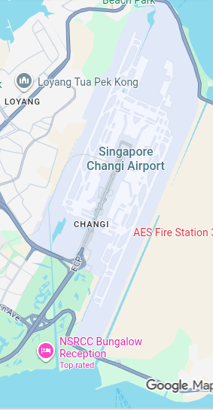
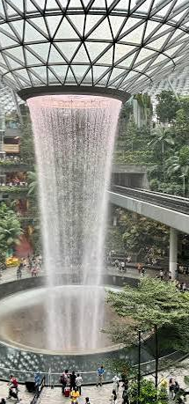
The Aspirational Place
Cit 9 WHERE
MAP SCREENSHOT | Singapore Changi Airport. Where do I begin? The architecture, the country, the prestige, it dignifies respect, honor and accomplishment all in one place. I would love to go to Singapore just for the airport alone. There's so much to do already and they're expanding by a sizeable amount! I need to go here, I know I'll love it. | IMAGE
Notes:
Reflection: Write a story about a place in the world that is part of your family's story.
Guiding Questions: What draws you to this place? What do you hope to learn or experience there? How does this place fit into your hopes for the future?

Slide 7
The Aspirational Place
Cit 9 WHERE
Soundtrack of your life |  | I don't have a definitive “childhood song.” There's plenty of options but there isn't any song that rings a bell or truly reminds me of my younger days, so unfortunately, I don't have a real, authentic answer to this. I hope you can understand.
Notes:
Reflection: Write a story about a place in the world that is part of your family's story.
Guiding Questions: What draws you to this place? What do you hope to learn or experience there? How does this place fit into your hopes for the future?

Slide 8
THANK YOU

